Slide 1
eBSEG Digital Banking Platform
eBSEG – Omnichannel Solution
Business and Retail Banking

Slide 2
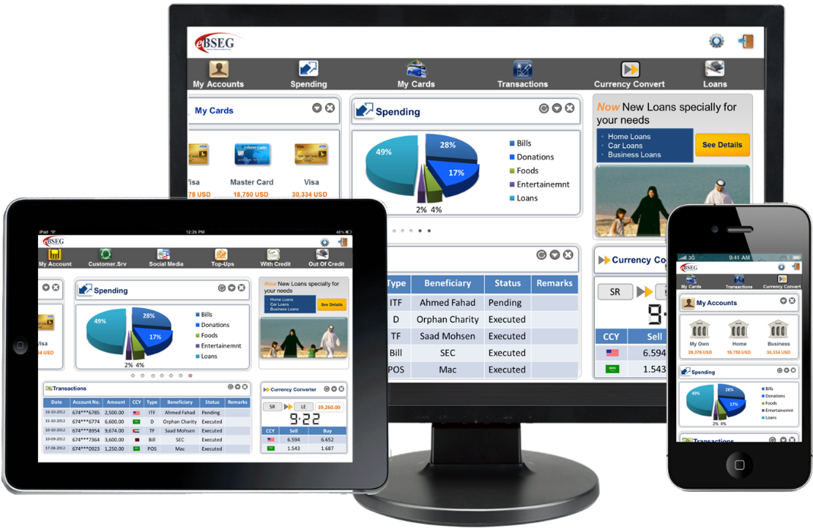
eBSEG: The Omni Channel Experience Company
eBSEG Customer Experience & Engagement Platform (CEEP)

Slide 3
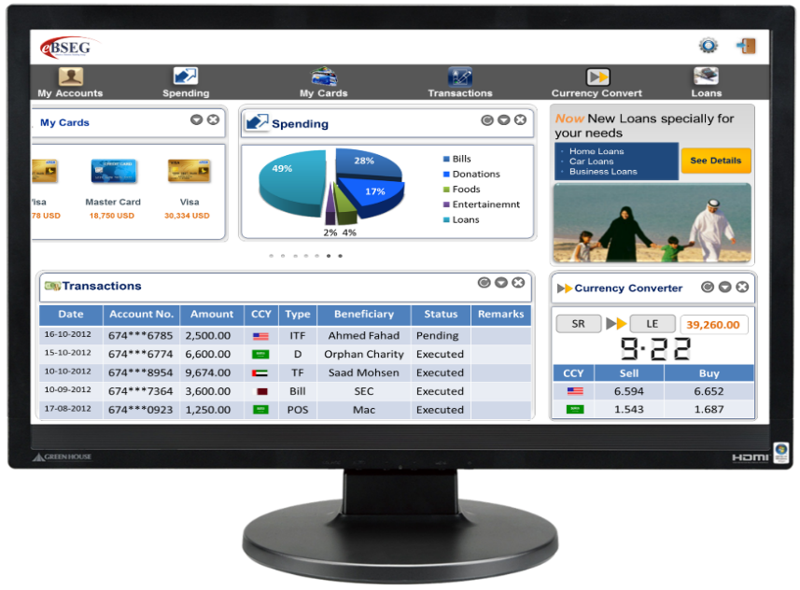
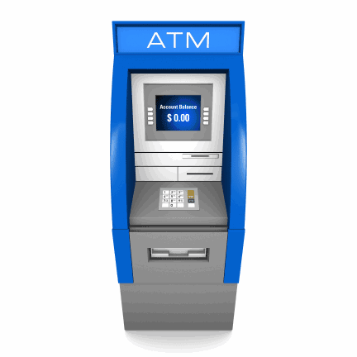

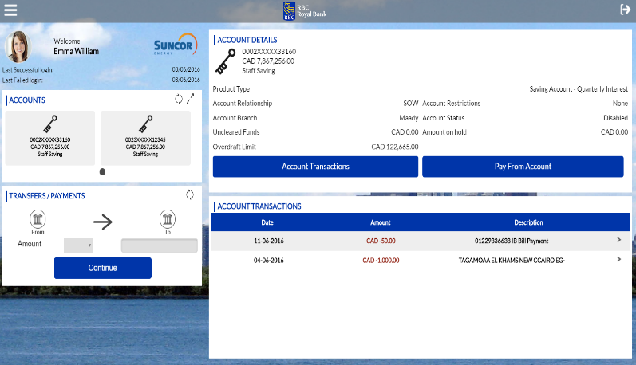
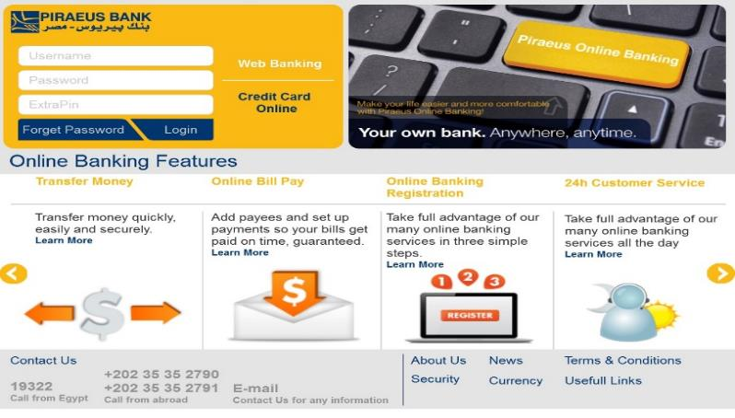
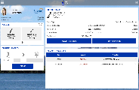

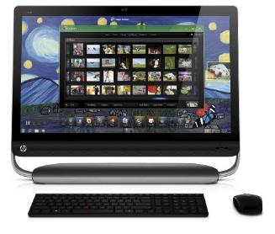
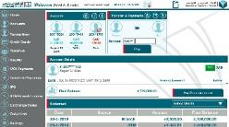
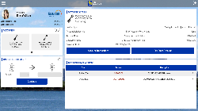
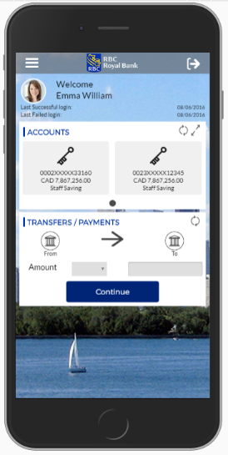
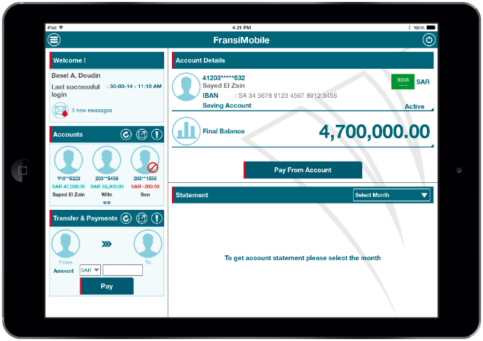


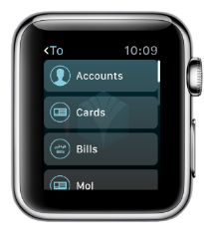


eBSEG CEEP: A Full Omni Channel Digital Platform
ATM
Call center
Web
Desktop
Kiosk – All in One Touch Stations
Mobile
Tablet
Apple Watch
Facebook
Digital Messaging Platform
SMS, Mobile Alerts, Messenger, WhatsApp , Emails, Voice , Fax …

Slide 4
About eBSEG

Slide 5
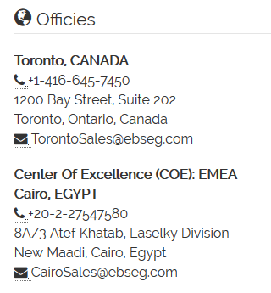

About eBSEG
eBSEG is a Canadian - Egyptian Software Company focused on platform technologies and Omnichannel customer engagement that has been operating since the year 2000 in North America and MENA.
Present in Egypt, Canada and USA with agencies in KSA and Qatar, eBSEG has a large network of partners spanning more than 10 countries.
Mission:
We are committed to leading the charge globally by helping Institutions serve up an amazing customer experience & engagement.
Core Values:
Not only deliver the Solution but also partner with the client to drive it into a Market success.

Slide 6
About eBSEG
20+ Years Experience & Presence..
Several Fortune 100 References
Unique Patent Pending Platform
One Platform reused for all Digital Experience
Global Omni Channel solution provider
Real Build once Deploy Many Omni Channel Platform for a wide range of industries.
Fast and Reliable Deployment
Unified Customer Experience & Consistent Features Solution over Channels
Preemptive Support (On-Site And Remote).

Slide 7
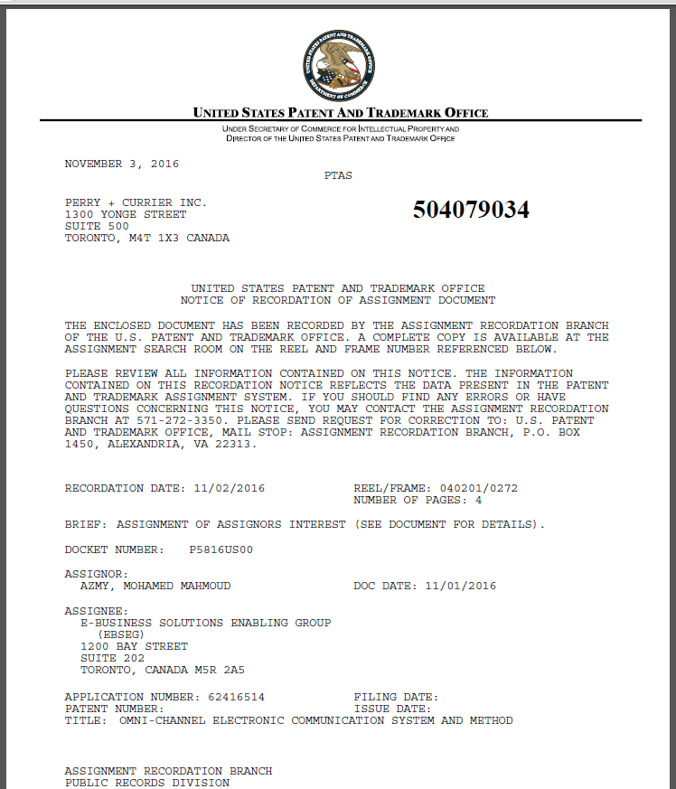
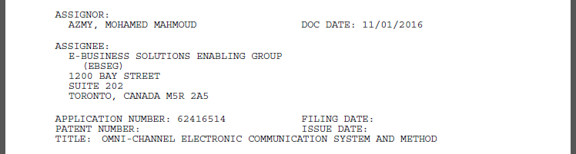
CEEPTM Patent

Slide 8
eBSEG Sample References

Slide 9

























Sample of References

Slide 10
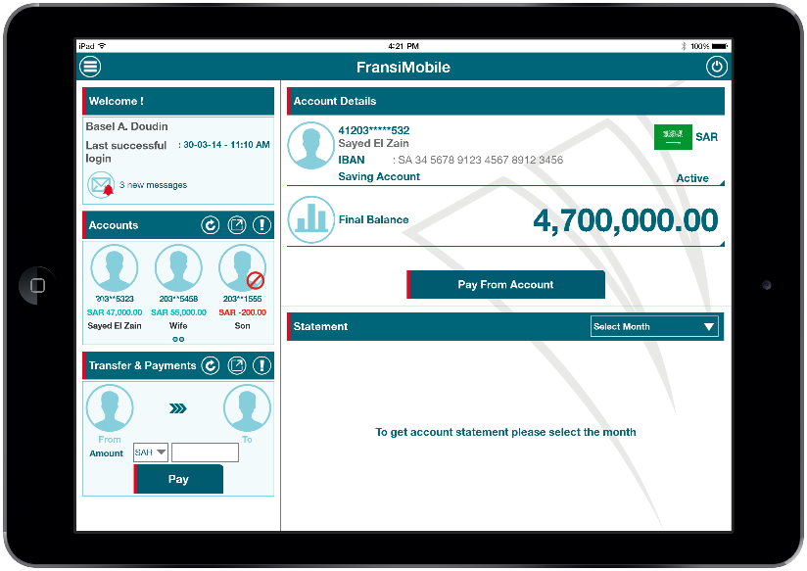
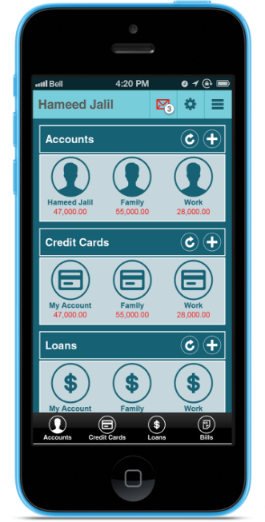

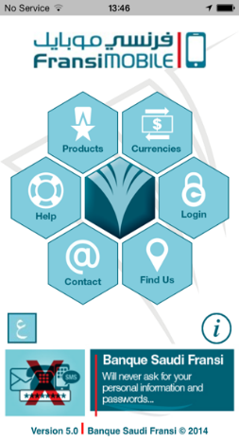
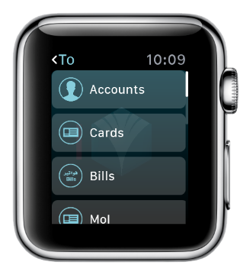
Bank Saudi Fransi (Old Design) (Award Winning)
2014-2018

Slide 11
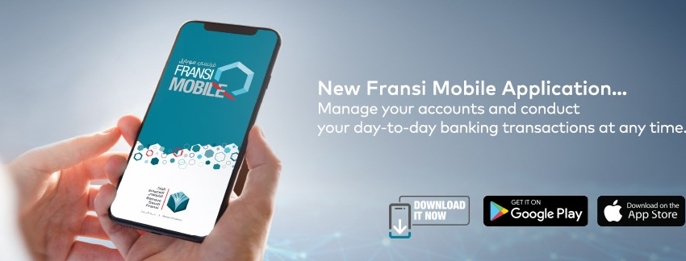
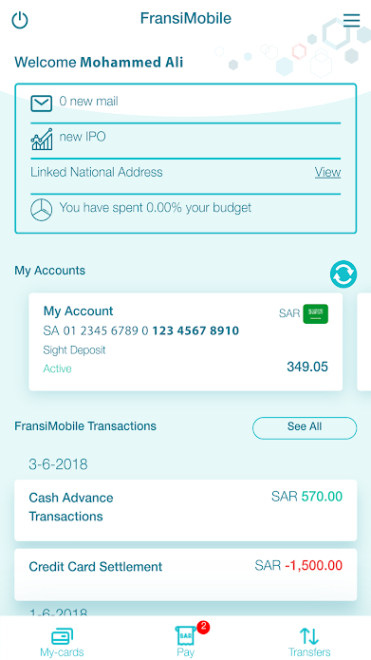
Bank Saudi Fransi (New Design)
2018-

Slide 12
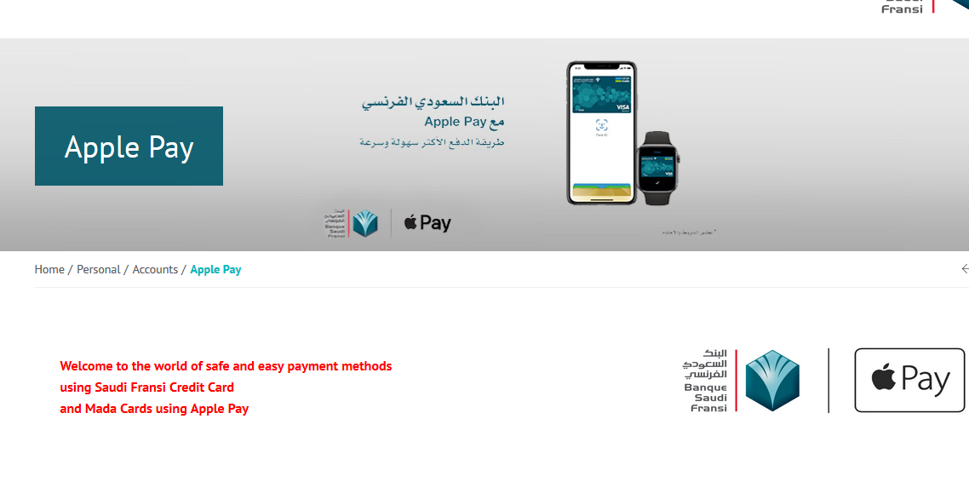
Bank Saudi Fransi - Apple Pay Support

Slide 13
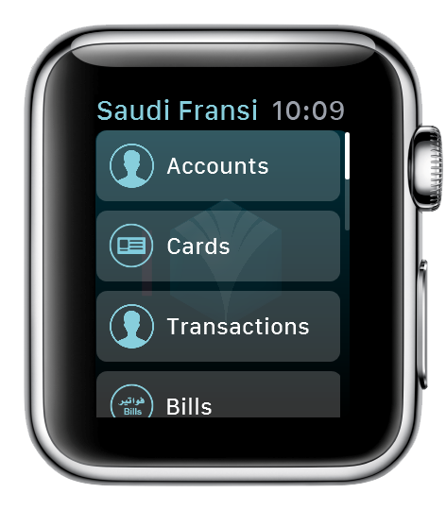
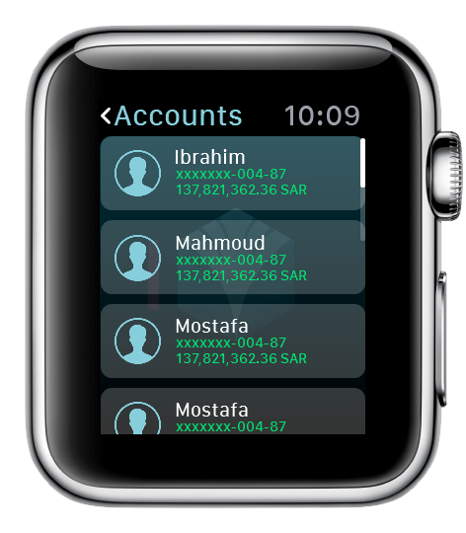
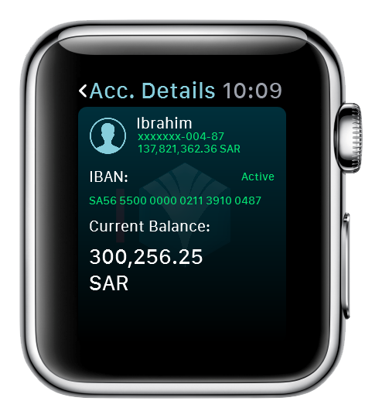

Slide 14
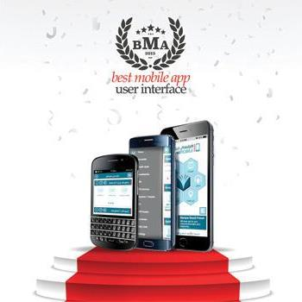
eBSEG Awards 2015 to 2018
Banque Saudi Fransi Mobile Application
For 3 Years 2015-2016-2018

Slide 15
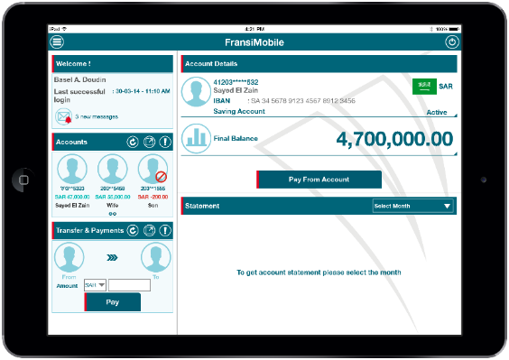

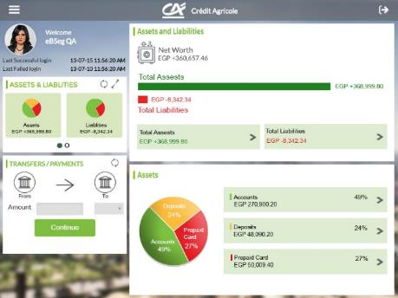
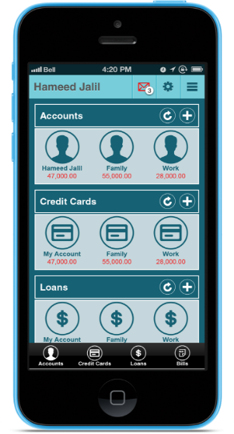
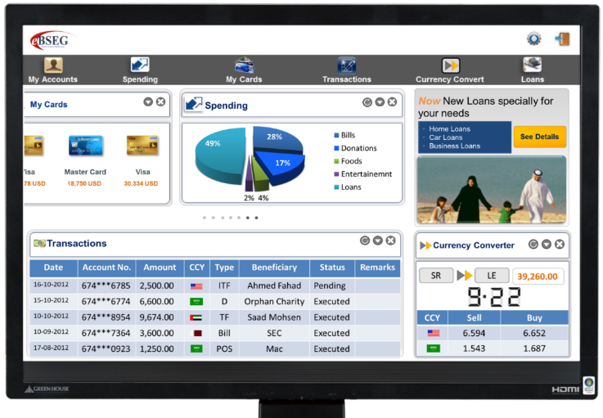
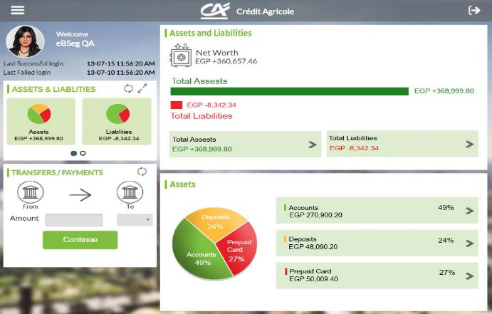

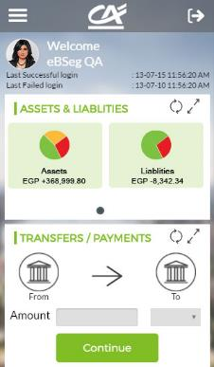
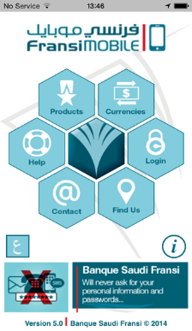
Credit Agricole Group – Full Omni Channel (Award Winning)
Full Omni Channel
1- Internet Banking
2- Mobile
3- Tablet
4- Branch Experience – Mobile Queueing
5- Geo Location Marketing
6- On boarding/Upselling
Credit Agricole Group

Slide 16
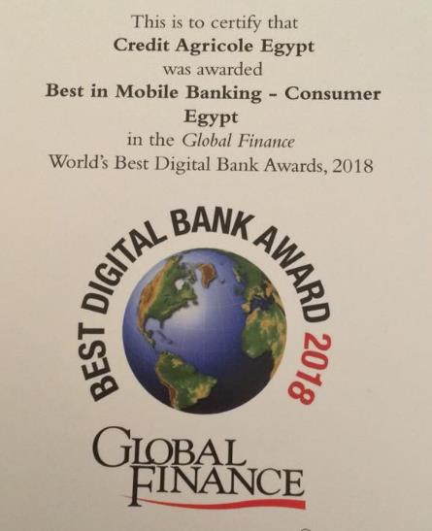
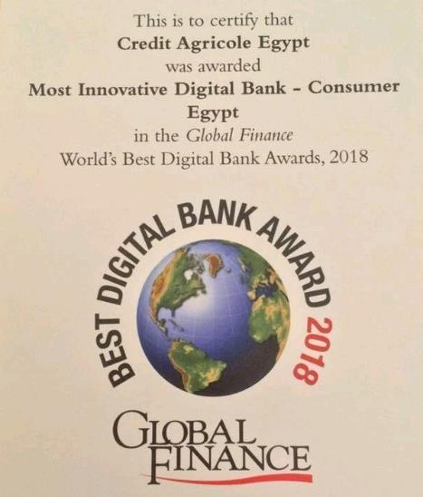
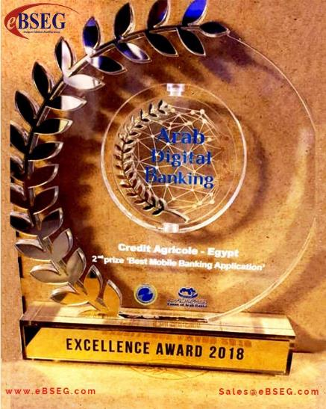
eBSEG Awards 2018
Global Finance Award
Credit Agricole Egypt
Best in Mobile Banking
Most Innovative Digital Bank Application
2018
Arab Digital Banking Award
Credit Agricole Egypt
2nd Prize Best Mobile Banking Application 2018

Slide 17
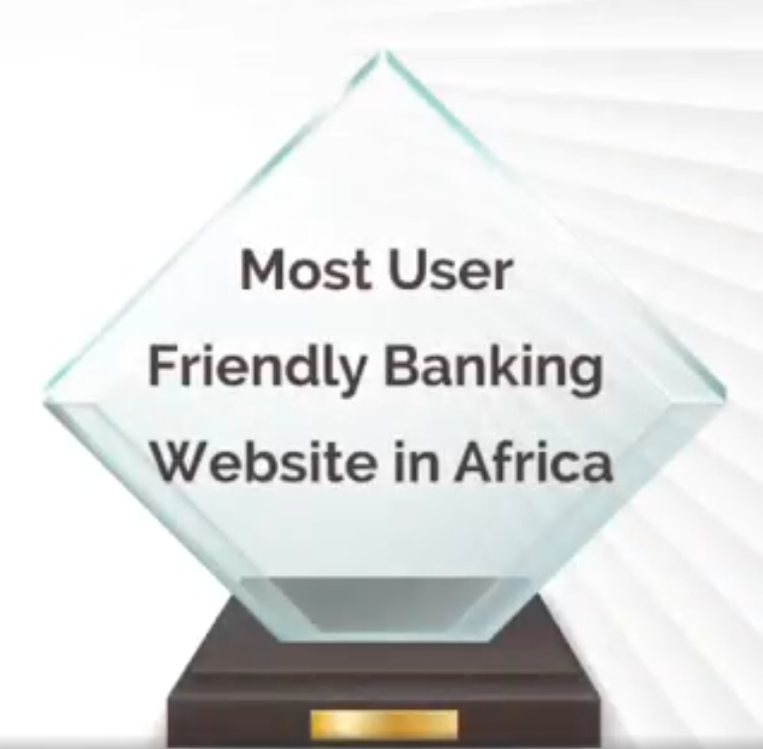
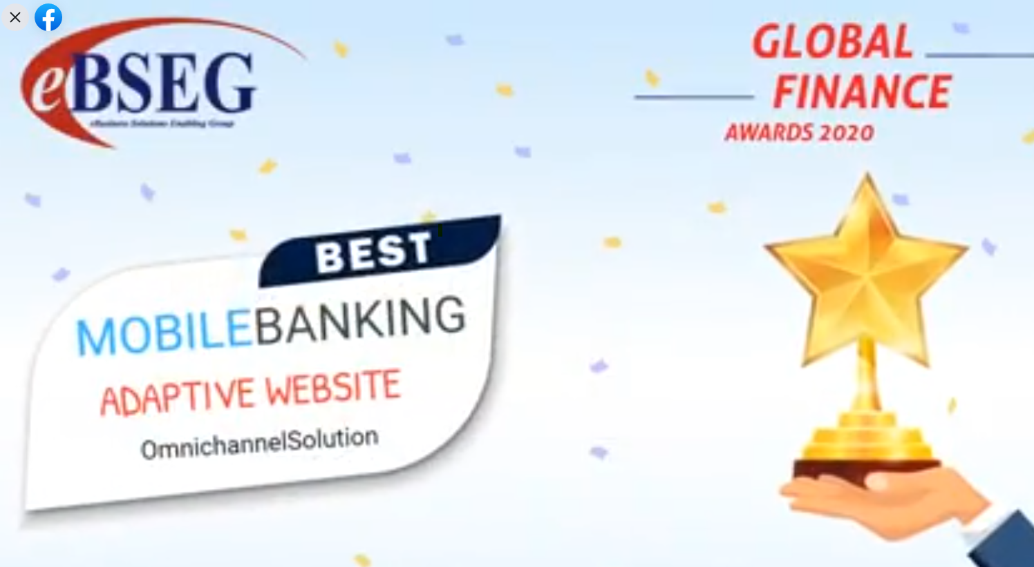
eBSEG Awards 2020
Global Finance Award 2020
Credit Agricole Egypt
Best in Omnichannel Banking
Global Brands Award
Most Friendly Banking
Website in Africa 2020

Slide 18

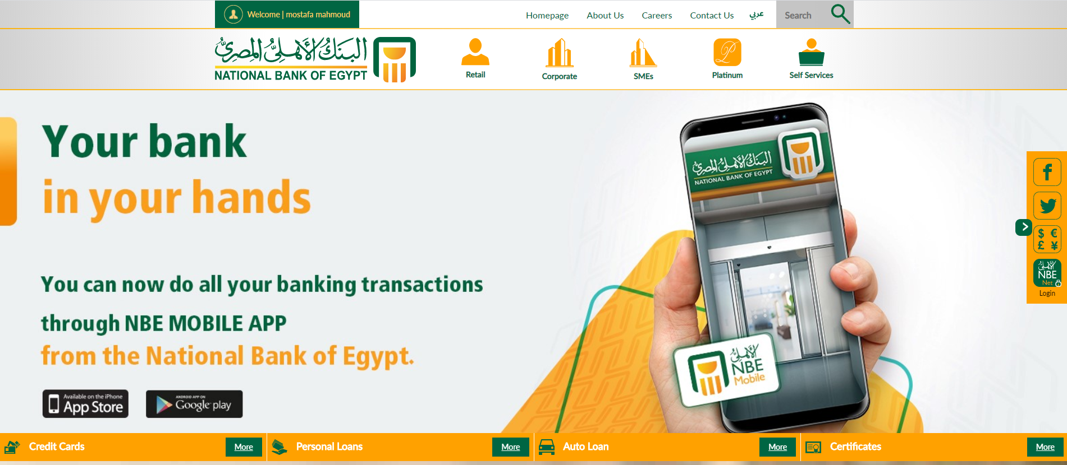
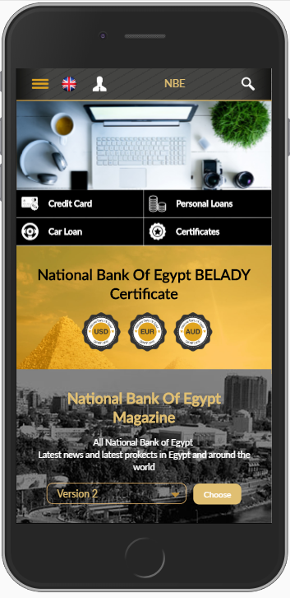
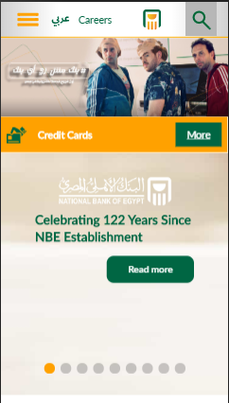
eBSEG NBE Public eBanking Portal (Award Winning)

Slide 19

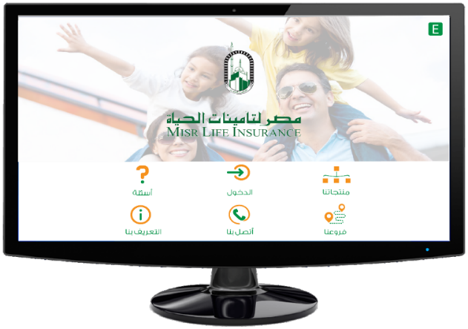
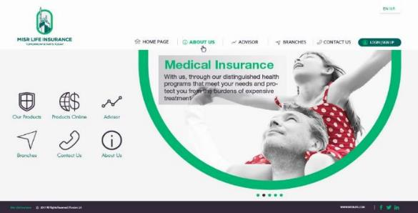
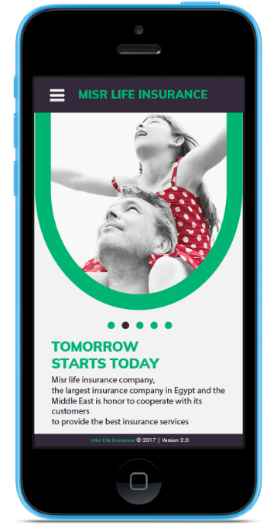
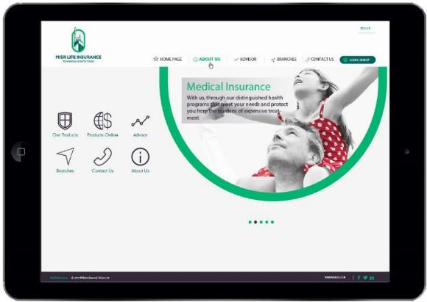
Misr Life Insurance
Omni Channel
Digital Transformation Project
1- Internet Insurance
2- Mobile Insurance
3- Tablet Insurance
Online Sales, Customer Service, Agent Services

Slide 20
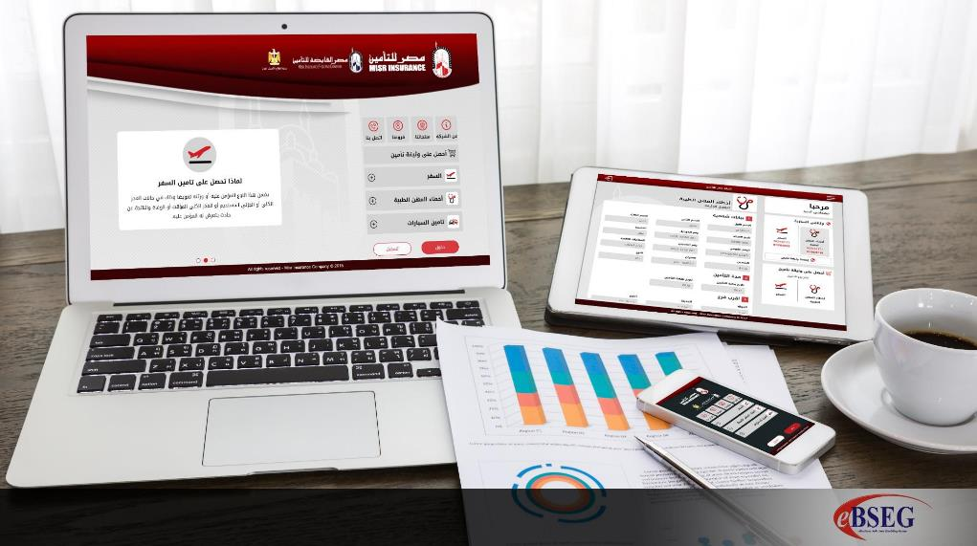
Misr Insurance
Omni Channel
Digital Transformation Project
1- Internet Insurance
2- Mobile Insurance
3- Tablet Insurance
Travel, Car, Medical …

Slide 21
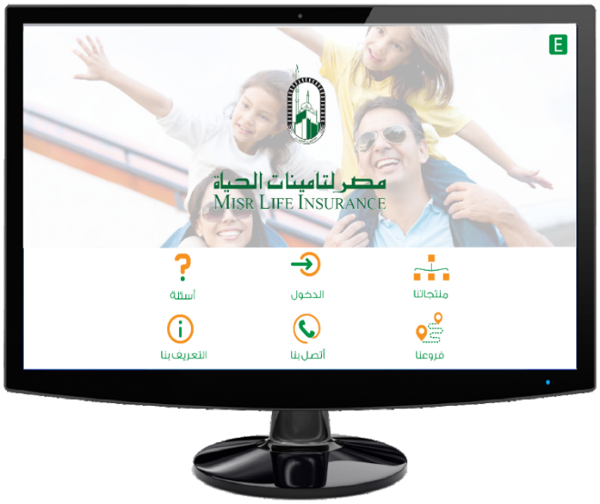


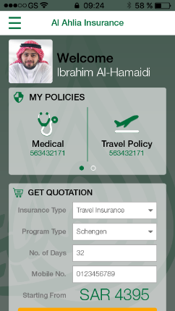

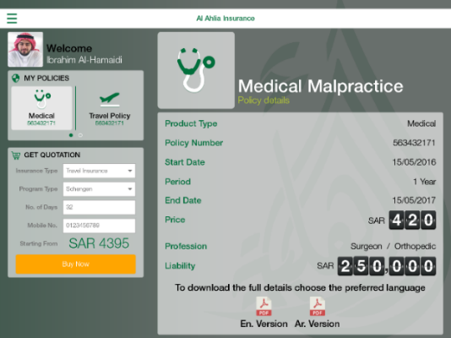
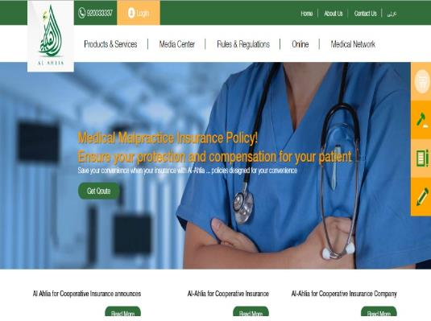
Al Ahlia Insurance KSA
Omni Channel
Digital Transformation Project
1- Internet Insurance
2- Mobile Insurance
3- Tablet Insurance
Travel, Car, Medical …

Slide 22
Omni Channel Road Map eBSEG Your Partner for Now and the Future

Slide 23
41 Innovative Solutions for Banks
      Omni Channel eBanking
    Mobile Banking
    Tablet Banking
    Internet Banking (Desktop)
    Digital Sales & On-Boarding
    Digtial Assitant Banking
    Business Banking Omni channel
    Apple Watch Banking
    Mobile Check Deposit
    Personal Finance Management
    Family Banking
    eBank Marketing
      Omni Channel Social Banking
    eAquisition from Facebook
    eWallet Services on Facebook
    Full eBanking from Facebook
      Omni Channel Enterprise Alerting
    SMS Alerts
    Mobile & Social Alerts (iOS, Android, Messenger, WhatsApp)
      Omni Channel ATM
    ATM Touch Banking
    ATM Touch ID Authentication
    ATM Beacon Authentication
    ATM Mobile Cash Withdrawal
      Omni Channel Call Center
    eAquisition Module
    CTI Popup & Banking Data Module
    Online Banking Through Agent
    Online Chat Banking
      Omni Channel Branch
    In Branch Touch Banking
    Assisted Sales eAquisition System
    Self Service Banking/Sales
    Mobile Branch Beacon Queueing
    Mobile Branch Beacon Assistance/VIP
    Branch Analytics
      Omni Channel Marketing
    Geo Location Marketing
    Mobile Points/ Redemption
      Omni Channel Sales
    Online Sales Acquisition/Upselling
      Omni Channel Mobile Payment/Wallet
    Mobile Pay Person to Person
    Mobile Pay Person to Merchant
    QR Payment
    NFC/Wireless Payment
      Omni Channel Remote Sales
    Sales Agent Tablet
      Omni Channel Intranet
    Employee Self Services
    Social Intranet Services
    Digtial Assitant Intranet Services

Slide 24
eBSEG Omni Channel Solutions
NexGen for NBE 2021 and Beyond
Road Map to Success

Slide 25
eBSEG Digital Sales & Onboarding Platform

Slide 26
Banking Products that can be sold Online
Accounts
Cards
TD & CD
Finance & Loans
Insurance
Retail Banking
Corporate Banking
Corp Accounts
LCs , LGs
Credit / Finance
Payroll
Insurance

Slide 27


Digital Sales & Onboarding Platform Modules
Step 1: Product Browsing and Comparisons
  Product Catalog
  Product Comparison
Step 2: Study/Customize Product Variables
  Simulators
  Calculators
Step 3: Buy/Apply for Product
  Customer fills eForms related to product
  Optional check National ID in National Databases or eSignature Services/Archive
Step 4: Upload Required Documents (Optional)
  Either Ask customer to upload documents needed
  Or Retrieve Customer Documents from National eSignature Services/Archives
  Or both
Step 5: Pay/Transfer Required Amount (Optional)
  Credit Card
  Swift Transfer
  Fawry/SADAD Payment
Step 6: Bank Verification
  iScore Check (Automated if possible)
  Check AML Systems
  Check Eligibility Business Rules
  Uploaded Document verification By Humans
Step 7: Internal Workflow/API
  Either use STP API
  Integrate with CRM or other workflow System
  Integrate using RPA Systems
  Totally offline
Step 8: Two way Deal Discussion/Chat (Optional)
  Two way Messages with Bank on Application
    Customer can ask about his application
    Bank can ask for more documents or request to complete process
Step 9: Single Branch Visit by Appointment
  Confirm/Notify Customer Deal is Ready and Original or Ink Signature
  Customer Select Branch and Appointment Slot
  Branch console
    Alert Branch team of customer visit Appointment
    Print all docs and have all ready for Customer Visit
Text Marked in RED is NOT
implemented in Current
Public NBE Portal
Solution

Slide 28
Customer Journey on Channels
Product Browsing and Comparisons
Study/Customize Product Variables
Buy/Apply for Product
Upload Required Documents (Optional)
Pay/Transfer Required Amount
Product Catalog
Product Comparison
Simulators
Calculators
Fills e-Forms related to product
Optional check National ID in National Databases eSignature Services/Archive
Customer to upload documents needed
Retrieve Customer Documents from National eSignature Services/Archives
Credit Card Swift Transfer Fawry/SADAD Payment
Others
1
2
3
4
5

Slide 29
Digital Sales & Onboarding Platform Solution
1
Omni channel Solution
2
eBanking Services for Public Customer
On Boarding/ Acquisition Systems
3
4
Content Management /Administration back-end management
5
Customized features capabilities
Full Online Payment Integration with MIG Payment Gateway in both Modes
6
This Portal is a 100% Dynamic Portal
Seamless Integration with Internet Banking
Very Advanced Reporting and Analytics
7
8
9
Integration with Chat bot Technology (Optional Project)
Full Banking solution certified PCI and Security with Pen Tests
10
11

Slide 30
Back Office
Bank Back Office Operations
Bank Verification
iScore Check (Automated if possible)
Uploaded Document verification By Humans
Internal Workflow/API
Either use STP API
Integrate with CRM or other workflow System
Integrate using RPA Systems
Totally offline
Two way Deal Discussion/Chat
Two way Messages with Bank on Application
Customer can ask about his application
Bank can ask for more documents or request to complete process
Signature
When all is Ready and need Originals and/or Customer Ink Signature
1
2
3
4
Notes:
Step 6: Bank Verification iScore Check (Automated if possible) Uploaded Document verification By Humans Step 7: Internal Workflow/API Either use STP API Integrate with CRM or other workflow System Integrate using RPA Systems Totally offline Step 8: Two way Deal Discussion/Chat (Optional) Two way Messages with Bank on Application Customer can ask about his application Bank can ask for more documents or request to complete process Step 9: When all is Ready and need Originals and/or Customer Ink Signature

Slide 31



How eBSEG Digital Sales Platform work
A Pluggable Platform of component that can be defined for each product or product group
Product Catalog
e-Forms
Pay / Transfer
Calculators
Upload Docs
Verify / Close Deal
Show Customer different products and Let him do comparison
Study and Customize Product Variables
Buy/Apply for Product
Upload Required Documents
Allow Customer to Pay/Transfer
Verify Deal

Slide 32

Product Catalog – Products Short Info

Slide 33

Product Comparison Shopping

Slide 34


Digital Sales & Onboarding Platform – Loan Calculators
(Not implemented)

Slide 35


Online Application form for Product

Slide 36

Step 4: Upload Required Documents (Optional)

Slide 37

Online Payment – Credit Card - Swift

Slide 38

Credit Card Payment -Card Data

Slide 39


On Boarding – Bank-Customer Chat
Customer can send chat message to Bank Operations Team
Online Chat between
Customer and Bank employee
Bank Operations Receives Message from customer and respond to it

Slide 40

Single Branch Visit by Appointment
Bank Digital Sales System

Slide 41

On Boarding – Admin Handling

Slide 42
Banking Sales Channels
Phone Banking
Call Center
Branch banking
Signatures and form filling
Information and update customer information
Transfers
Sales
Banking support
Withdrawal and Deposits
E-payments
Checks collection
Applications
Banking Support
Kiosk and in Branch Touch Screens
Automated banking
Mobile and Internet banking
Transfers
E-applications
Information surf
Promotions
Direct sales
Offers
Alerts
Bill payments
ATM
Deposits and Withdrawals
Account information
Check deposits

Slide 43

Digital Sales & Onboarding Platform - High Level Design
Distribution Channels
Digital Sales & Onboarding Platform Platform Portal
BackOffice Perimeter
STP Work Flows
Offline Requests Workflows
Core and Backend systems Integration
Product Showcase and comparison
eForms
Service and fees Calculators
Online payments
Verifications
Notification and Alerts
Self service portal
Documentation Upload
Export product documentations to PDF
Core and Backend systems Integration
Product Showcase and comparison
Advanced eForms
Service and fees Calculators
Online payments
Verifications
Notification and Alerts
Self service portal
Advanced Documentation Upload (PDF, Doc, Image, Multiple documents
Export product documentations to PDF
Service Fees Declarations
Advanced Two way status update notifications
CRM integrations
Call Center integrations
Payment Reports
KYC integrations
Regulatory and Reporting
Cash / Transactions Reports
Payment Reports
AML / Fraud systems Integration
KYC Integration
Cycle Analytics
Service Monitoring

Slide 44
eBSEG Digital Branch Solutions

Slide 45

eBSEG Solution 1
Omni Channel Branch
Assisted Sales eAquisition System
RO can use Acquisition module to initiate Sales to Customers in an interactive method
RO gets unfinished transaction of customer...specially sales transactions

Slide 46







eBSEG Solution 2
Omni Channel Branch
Self Service Banking/Sales
Customers or Non Customers can access self services in Branch for non cash transactions using
  All in one pc
  Kiosk
  Touch tables

Slide 47

Omni Channel Branch
Advantages for the client
Familiar interface, unified user experience
Offer the client the freedom bypassing teller lines and quickly completing typical branch transactions, such as account opening, account maintenance, appointment booking and check-in and financial product research and purchase

Slide 48

Omni Channel Branch
Advantages for the bank
More cross-sale and up-sale opportunities
Frees up your tellers to concentrate on value-added activities, such as sales and service
Money Saver, where it’s One-time payment for solution

Slide 49





eBSEG Solution 3
Omni Channel Branch
Digital Branch Auto Detect Experience
Digital Branch Auto Detect Experience
  Alert RO for VIP Customers (that have eBSEG App installed)
  Show full Customer Info to RO as customer walks into branch
  Show possible In Branch Offers to customer based on integration with and existing Next best offer backend system

Slide 50

eBSEG Solution 4
Omni Channel Branch
Branch Analytics
Branch Analytics!
Organization will be able to understand which customers are using branches.
what are the busiest days and times, how long on average are customers spending in branches and what type of services customers are completing.
Requirement: Place an Beacon at Branch Entrance

Slide 51
Omni Channel Call Center eBSEG Solutions

Slide 52

eBSEG Solution 1
Omni Channel Call Center
Digital Sales/On-Boarding Module
Agent can use Digital Sales/On-Boarding module to initiate Sales on behalf of Customers to as much as possible steps in the process
Agent gets unfinished Digital Sales/On-Boarding requests made by customer when he calls and can finish it for him

Slide 53

eBSEG Solution 2
Omni Channel Call Center
Online Banking Through Agent
Agent can initiate eBanking transactions on behalf of customers
  Agent creates transaction on his screen for example a bill payment
  Agent Submits transaction for customer approval
  System sends customer an SMS with details of Transaction with otp
  Customer reviews the details of the transaction in the SMS he gets and informs the Agent the OTP or Token on the call
  Agent Enters the OTP/ Token as a kind of signature from the client
  System executes the transaction and SMS is sent to client showing execution details
Targets Client Segments that prefer Voice over traditional Online
  Ex: Senior Citizens , VIP Customers

Slide 54
Omni Channel ATM staging eBSEG Solution
“Much More than a cash machine”

Slide 55


eBSEG Solution 1
Omni Channel ATM
Full eBanking Service on ATM
Provide modern Touch Banking solution on ATM for non-cash services
Best on Touch based ATMS but also possible on Button Based with a new layout
Authentication is based on ATM Card
Does not replace existing Cash Service interface but adds to it Other services as needed

Slide 56

Clients can reach all banking services they need, transact their funds safely, make secure payments and check their Accounts

Slide 57


eBSEG Solution 2
Omni Channel ATM
Mobile Touch ID for ATM 2nd factor Authentication
Allow ATM User to make higher risk transactions with higher values for example by 2nd factor authentication from eBSEG provided mobile App

Slide 58



eBSEG Solution 3
Omni Channel ATM
Cardless Emergency Cash Withdraw
“Withdrawing cash using only Smartphones”
Mobile App can be used to withdraw cash from ATM
Cash can be limited to an Emergency Level Cash only
Optional Touch ID or In ATM iBeacon can be used for additional security

Slide 59
Intelligent Assistant Solution

Slide 60
eBSEG Digital Assistant Solutions

Slide 61


About Digital Assistant Solutions

Slide 62









Digtial Assitant Channels
Text channels
Speech channels
Apple Siri
In App

Slide 63
Digital Assistant + eBSEG CEEP Omni Channels
eBSEG Customer Experience & Engagement Platform (CEEP)
+
Inside Web Portal
In App

Slide 64


Bank Problems with Bot Clouds
CBE Forbid Customer Data to go to Cloud
Cost of Cloud is open Ended
Any Cloud
Any Vendor

Slide 65

eBSEG CEEP On-Perm ChatBot Save on Cloud Cost/Secure Data
Bank Secured Env
Save on
Cloud Cost
On Perm
eBSEG ChatBot built to fit Banks and Insurance Sector security needs

Slide 66
eBSEG CEEP Digital Assistant Features
Features | CEEP Digital Assistant
CEEP Search engine Like Intent discovery logic | þ
Intelligent Single Matching/Multi-Matching of Answers | þ
On prem Solution | þ
Does NOT Require Subscription License | þ
English Language Support | þ
Arabic Language Support | þ
Franco Arabic Language Support | þ
Highly Secure Login and Session Management for private data | þ
Ignore Words / Word Synonyms (Thesaurus) | þ
Auto Service Command Cleaning Feature | þ
Built in FAQ System | þ
Menu Driven Click through System for Structured Data | þ
Wizard Based Conversation for data gathering | þ
User Feedback/Satisfaction Module | þ
Omni Channel Chat that’s allows continue communication on different channel | þ
Content Full Admin controlled by Business Team with Full Reports for Stats and Tuning | þ
Messenger Customer handover to Agent and Backward | þ

Slide 67

eBSEG Digital Assistant – Support Voice Channels
Add the Voice Enabled channels
Alexa, Apple Siri, Google Assistant (when they allow Egypt)
Integration with Voice Channels

Slide 68
eBSEG Digital Assistant Functions

Slide 69

eBSEG Digital Assistant Functions for Phase 1
The following are examples of Proposed Banking Bot Services for Phase 1
Handle customer general inquires.
Branches/ATMs Locator.
  Integrated with Banki Data Module
Support to digital channels: "How to?”/User Guide.
Sales/On Boarding: to be integrated with either Public portal acquisition or Banki Acquisition

Slide 70
eBSEG Chat Possible Future Enhancement
The following are examples of possible Future Banking Bot Services Enhancement
  Account Balance Inquiry
  Card Available Balance
  Loan Outstanding Balance
  Account Transactions
  Card Transactions
  Account to Account Transfer
  Card Payment
  Bill Payment
  Block Card
  …

Slide 71


CA Banking Messenger Channel Bot

Slide 72
CA Banking Messenger Channel Bot

Slide 73
Omni Channel Remote Sales
Solution

Slide 74

Omni Channel Remote Sales
Sales Agent Tablet
Assisted Car Loan Acquisition System on Mobile/Tablet
Remote Sales Agent Deal Follow-up and Status System
On Board new Customers
Follow up Requests Status/Loan Approvals

Slide 75
Personal Finance Management

Slide 76


Personal Finance Management
Customer control and monitor the daily and monthly income/expense
Customer enter his monthly income and Savings Target category Values/% in a selected Month
Customer Classify transactions to spending category.
Bank gets huge InSite on Customer spending and plans that help in targeting and sales

Slide 77
Location Based Marketing

Slide 78


Location Based Marketing
“Egyptians Love Offers”
Customer will receive a notification on his/ her Mobile or Tablet only once s/he gets near by selected location(s) for each offer
Bank can sell service to Merchants & Promote their Services

Slide 79
Omnichannel Media Rich
Enterprise Messaging and Alerting

Slide 80

eBSEG eMessaging Scalable Enterprise Engagement Platform

Slide 81


Messaging Channels
Facebook
Messenger
WhatsApp
iOS & Android
Mobile Notifications
In App Box
SMS
MS Teams

Slide 82

    Financial Notifications

Slide 83
    Mobile Alerts Image Support

Slide 84
    In App Notification Center (Public and Private)

Slide 85

    Bulk/Marketing Advanced Message with Customer Actions Support

Slide 86

    Omnichannel Templates

Slide 87
Facebook Digital Solutions

Slide 88

Omni Channel Social Banking
eBSEG Solutions
“Your Strategy to Catch Millennials
with REAL Engagement Banking
Show your Bank on their Time Line”

Slide 89


Social Media – Facebook App
      Omni Channel Social Banking
    eAquisition from Facebook
    Full eBanking from Facebook

Slide 90

eBSEG Solution 1
Omni Channel Social Banking
Digital On-Boarding from Facebook
Show Banking Product Offers on Facebook Time Line and Page
Facebookers can study and buy loans , open accounts from Facebook Bank App
Bank App can show Offer to User and his friends

Slide 91



Sample Facebook App

Slide 92

Sample Facebook App

Slide 93

eBSEG Solution 2
Omni Channel Social eBanking from Facebook
Facebookers can have Full eBanking from Facebook

Slide 94



eBSEG Solution 1
Apple Watch

Slide 95

Thank You

