Slide 1

Credit Agricole
eBSEG UX Approach

Slide 2
Credit Agricole
Option 1: Use Standard eBSEG UX and brand/minor customize it for Bank needs

Slide 3
Credit Agricole
Design 1.1 (Brand New - Recommended)
This design is using different design elements in comparison to the existing Banki design and a fully new layout and would give the feeling to customer of brand-new design model

Slide 4
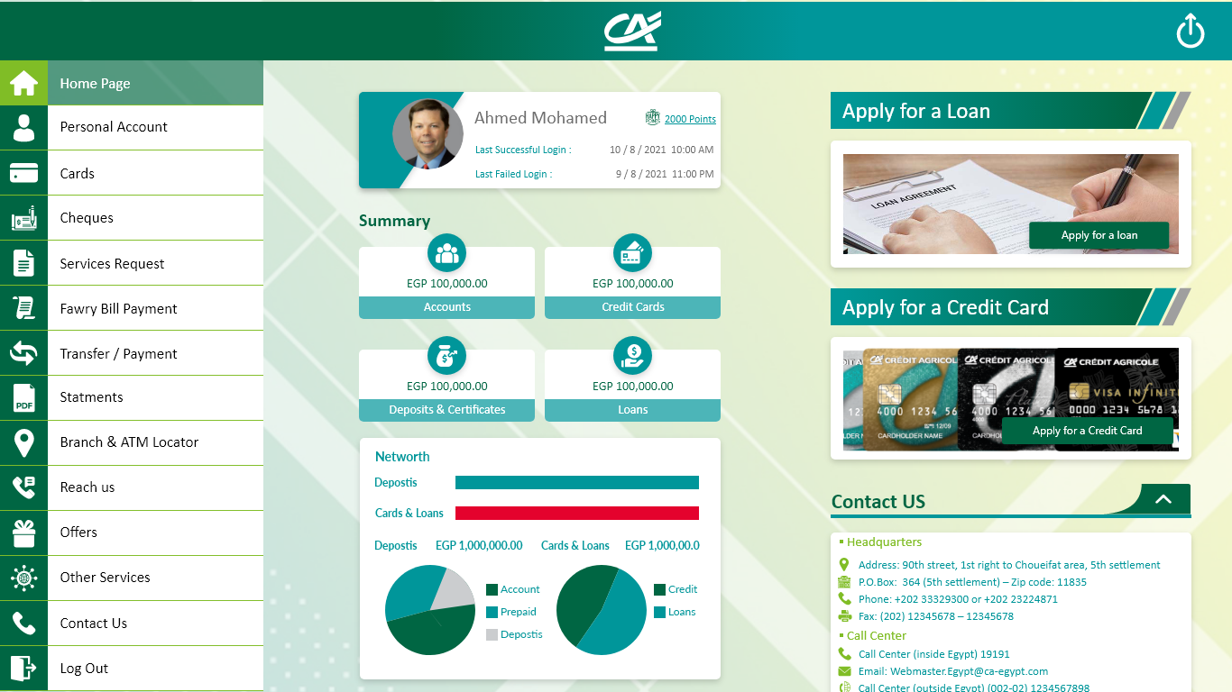

Slide 5
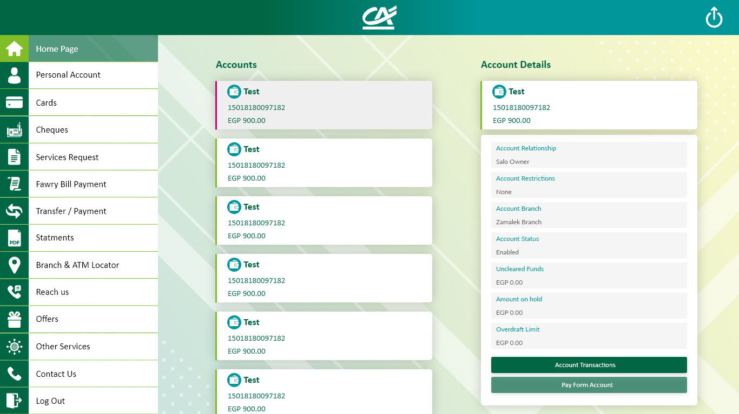

Slide 6
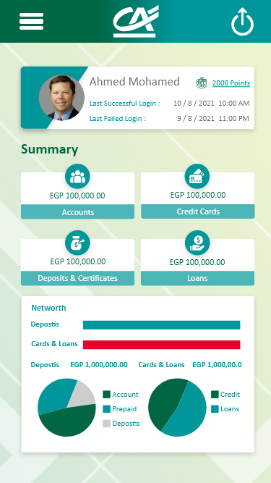
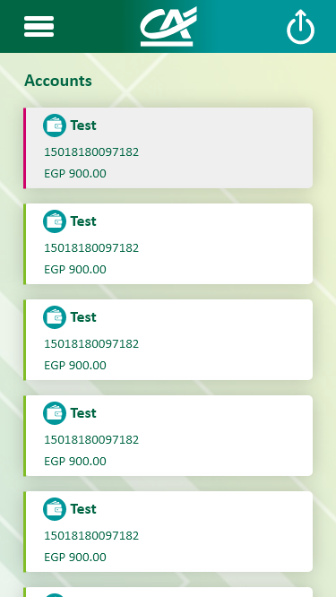
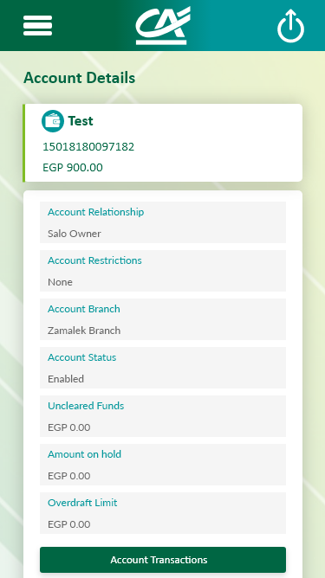

Slide 7
Credit Agricole
Design Option 1.2 (Brand New – Recommended 2)
This design is using different design elements in comparison to the existing Banki design and a fully new layout and would give the feeling to customer of brand-new design model

Slide 8
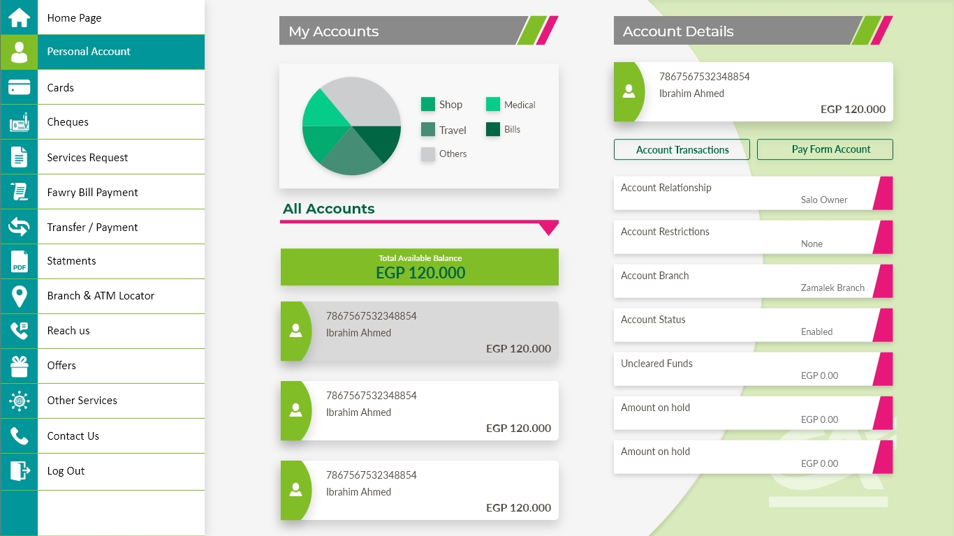

Slide 9
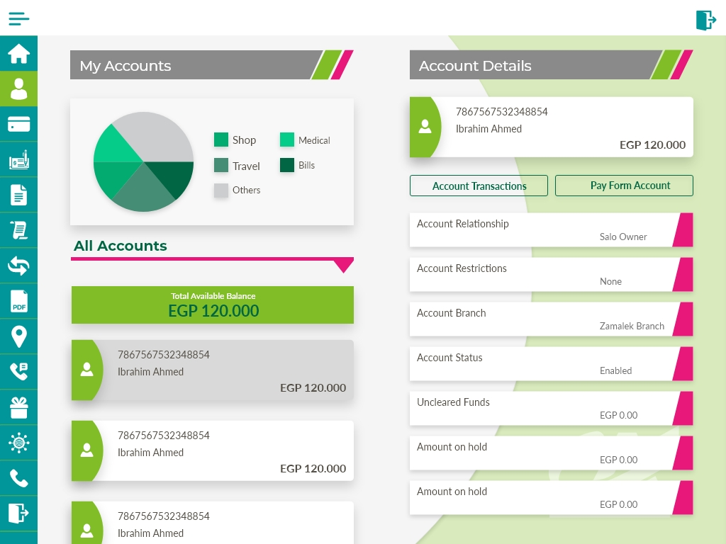

Slide 10
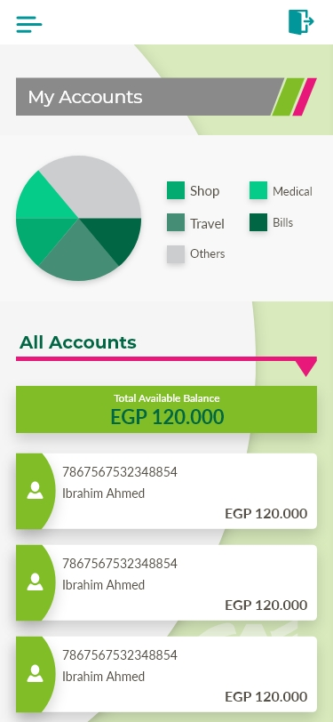
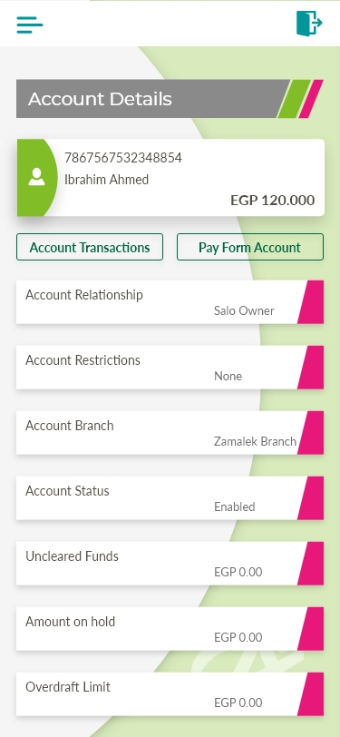

Slide 11
Credit Agricole
Design Option 1.3
This design is using somehow similar design elements as the existing Banki design but in a fully new layout and would give the feeling to customer of continuation of design model

Slide 12
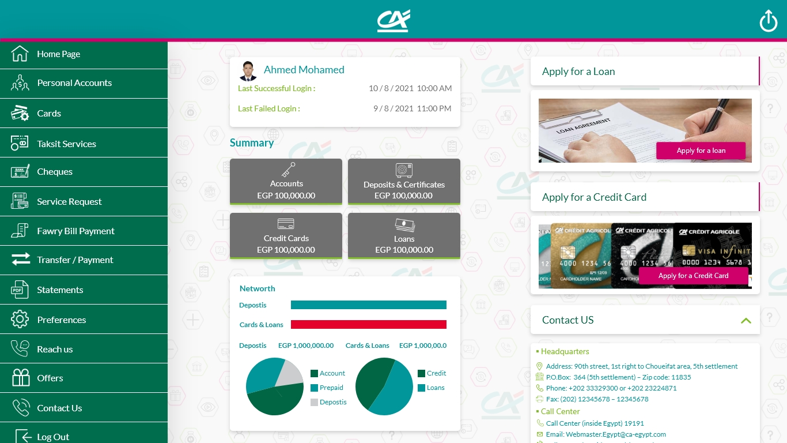

Slide 13
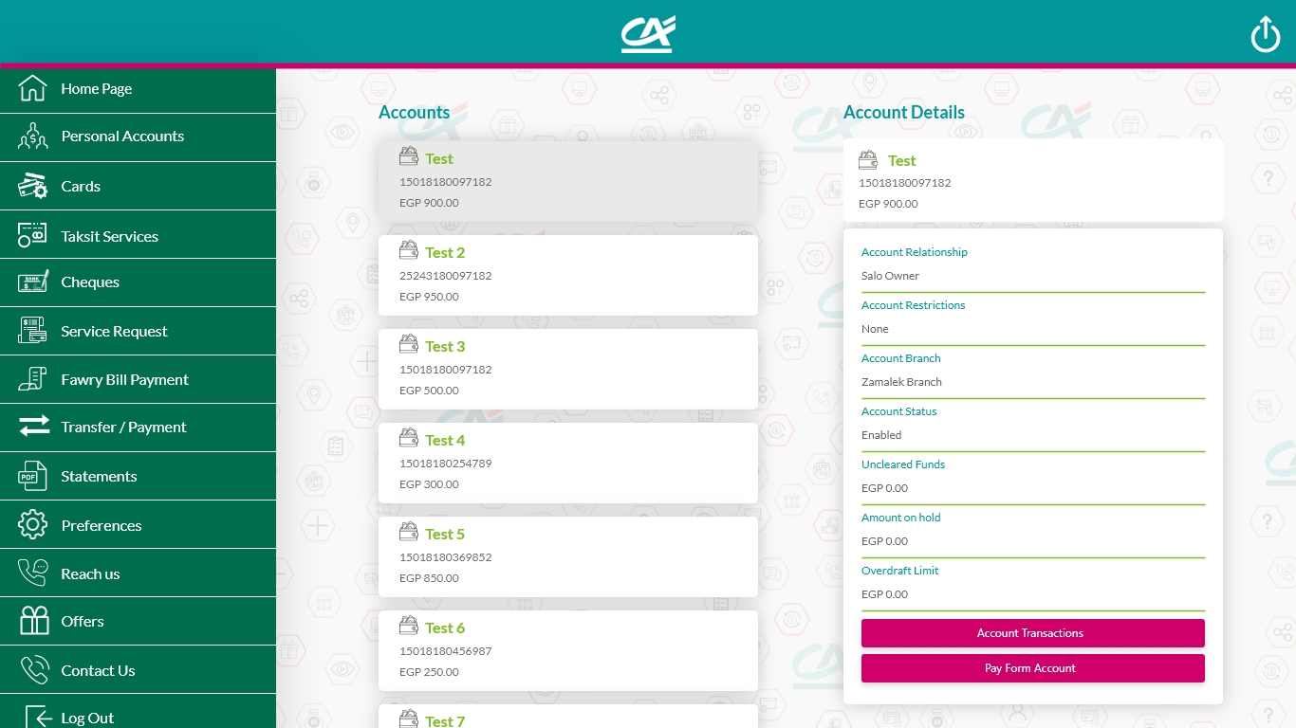

Slide 14
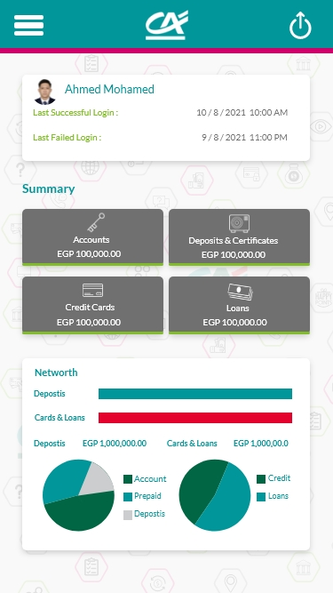
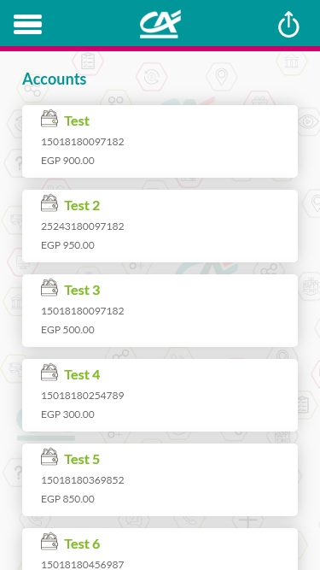
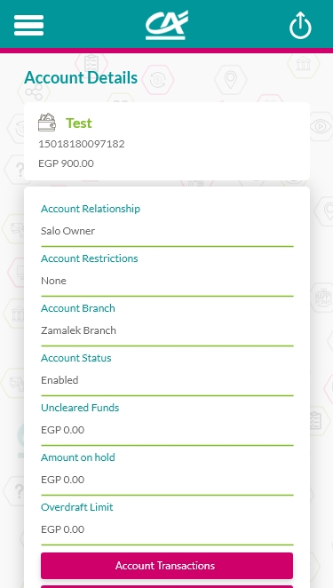

Slide 15
Credit Agricole
Design Option 1.4
This design is using somehow similar design elements as the existing Banki design but in a fully new layout and would give the feeling to customer of continuation of design model

Slide 16
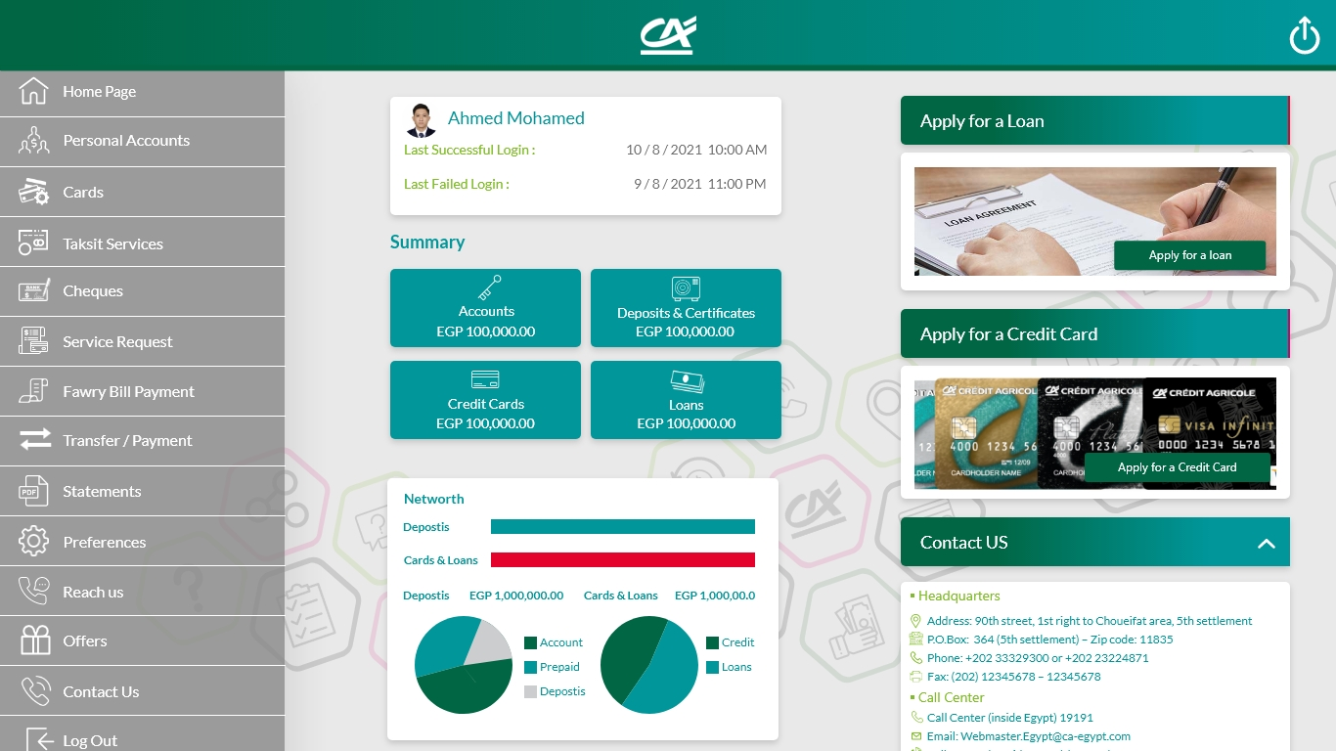

Slide 17
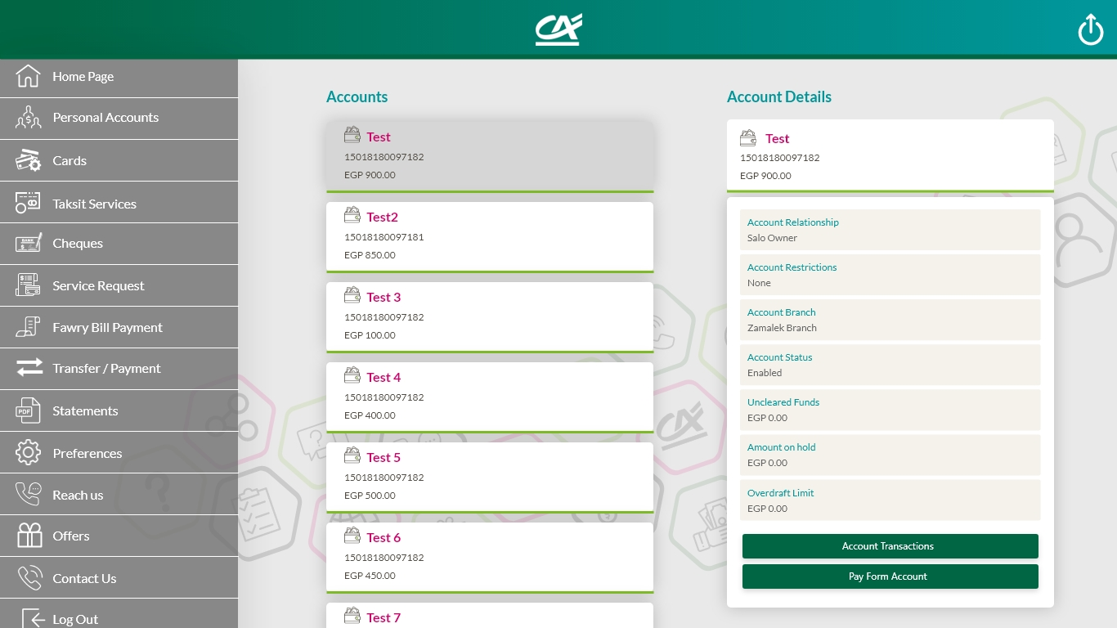

Slide 18
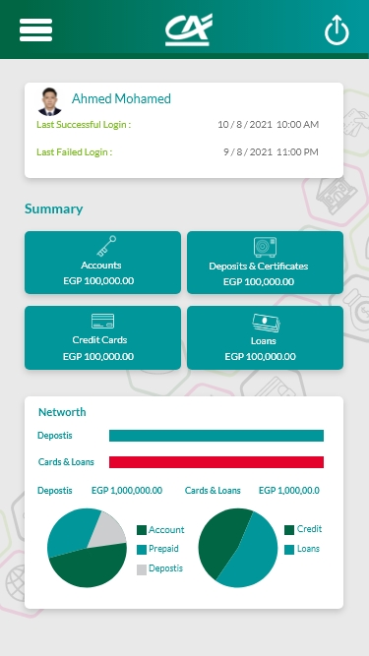
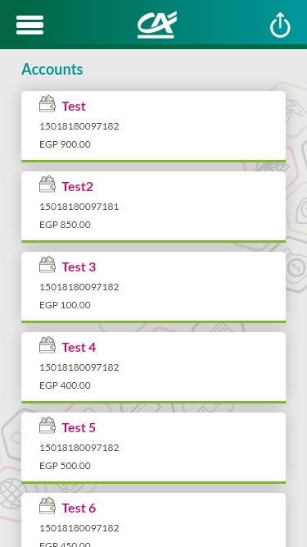
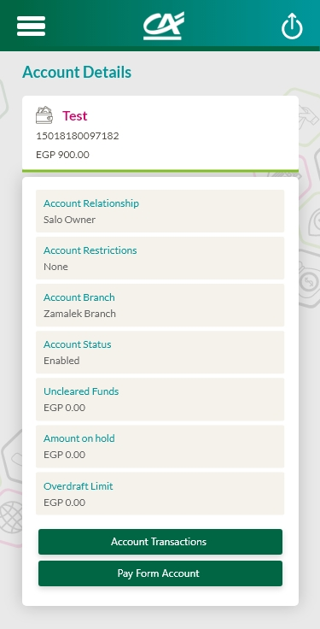

Slide 19
Credit Agricole
Option 2: Create a fully new/Custom UX

Slide 20
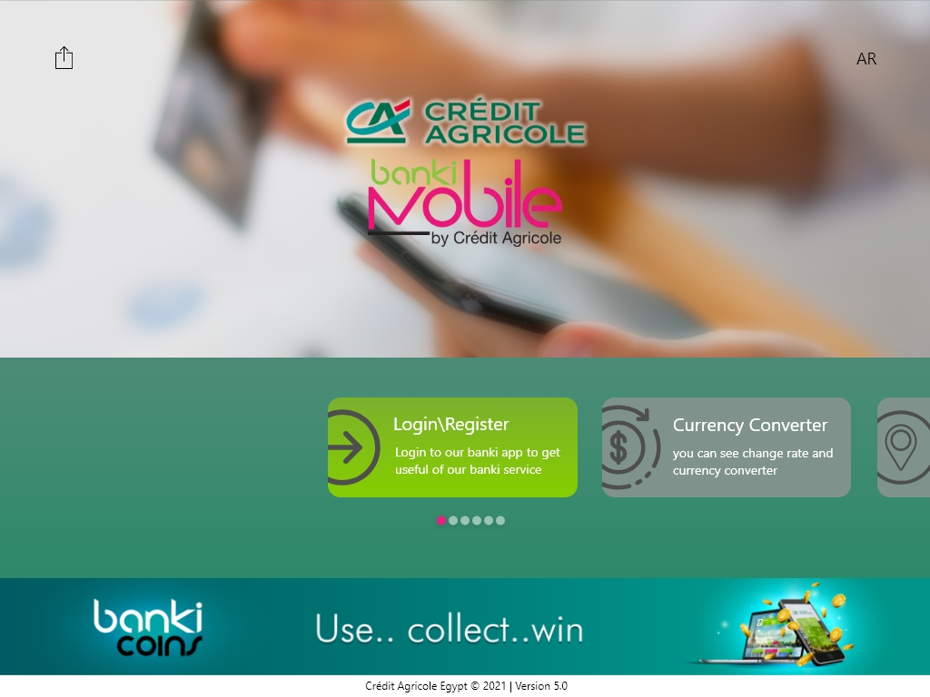

Slide 21
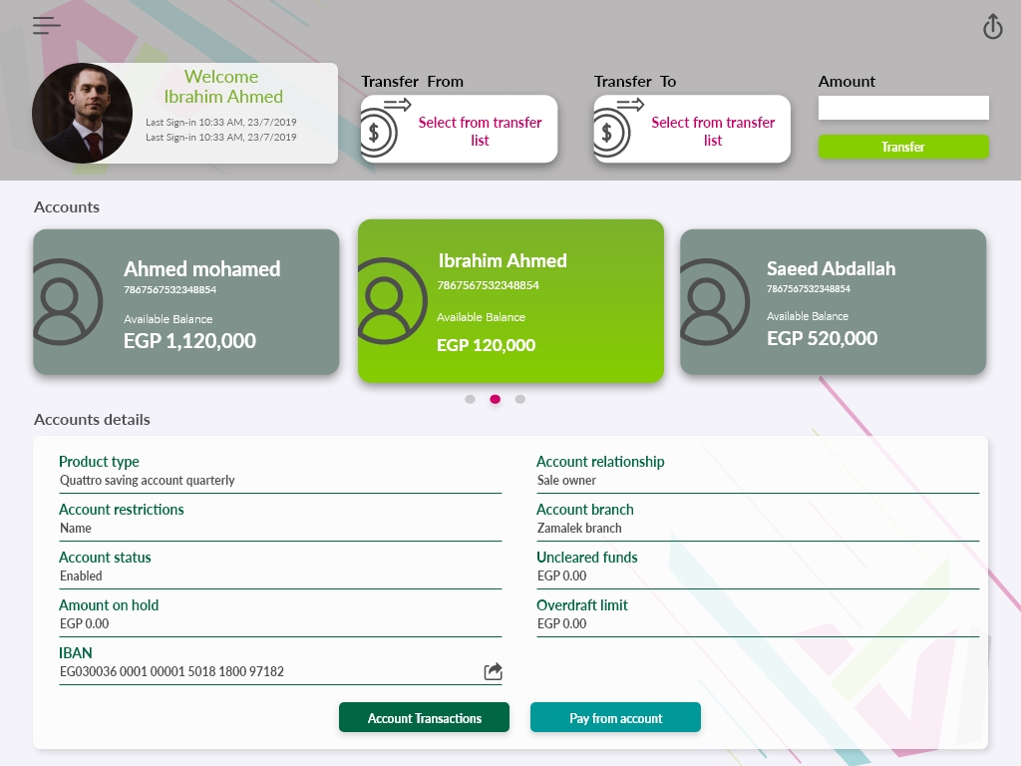

Slide 22
